Slide 1


AMERICA’S ARMY:
Globally Responsive, Regionally Engaged
UNCLASS/FOUO
United States Army Student Detachment
(USASD)
RESPONSIVE
Purpose:
To provide an overview of the services provided by the USASD to the best Soldiers in the United States Army
Agenda:
USASD Mission
TDA
Provided Services
In-Processing
Absence Requests
Finance
Out-processing
Essential Personnel Services
Closing comments
Welcome Brief
20240819

Slide 2




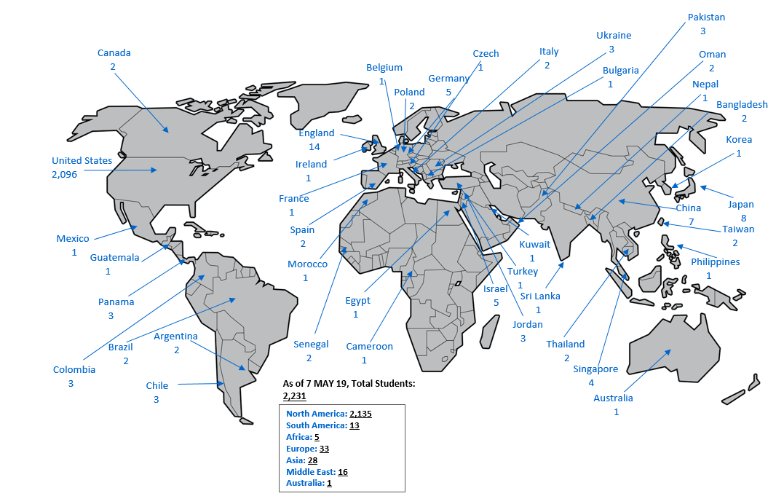
USASD Mission
Training and Doctrine Command (TRADOC)
U.S. Army Center for Initial Military Training (CIMT)
Leader Training Brigade
USA Student Detachment
Proponent Development & Integration Division
USA Master Resilience
School
USA Physical Fitness School
IMT Leadership School
USA Drill Sergeant Academy
Mission: The U.S. Army Student Detachment provides command and control, human resources and financial management support, and medical readiness to more than 1,700 U.S. Army personnel attending civilian educational institutions and designated Armed Forces Service Schools in CONUS, and OCONUS locations to ensure their successful tour of study.
Advanced Civil School (ACS) Program
- Graduate (Masters) (JD) (PhD)
Broadening Assignments
- Fellowships
- Funded Legal Education Program (FLEP)
- Office of the Chief Legislative Liaison, Strategic Education
& Development Program, Bachelor’s Degree Completion Program (DCP)
- Scholars: Olmsted Scholarship & General Downing Scholarship
- Foreign Area Officer In-Region-Training (FAO-IRT)
- NDU
Joint Service Schools ILE
- Air Command and Staff College, Maxwell Airforce Base, AL
- Marine Corps Command and Staff College, Quantico, VA
- Naval Command and Staff College, Newport, RI
- Naval Post Graduate School (NPS), Monterey, CA
Training With Industry/Acquisition Program (TWI)
Sons of Other Nations (SON) Foreign School ILE
- 114 OCONUS locations - WIAS Taskers deployment
- In-Processing (New Arrivals)
8/23/2024
2

Slide 3
USASD TDA
Commander
O4 – AG
First Sergeant
E8 – 42A
DET HQs
Human Resources Support Section
Financial Services Section
HR Supvr (MIL/OA)
GS-0201-09
HR SGT
E5 – 42A
Admin Asst
GS-0203-06
HR Asst (MIL/OA)
GS-0203-07
HR SGT
E6 – 42A
HR Asst (MIL/OA)
GS-0203-07
HR SGT
E5 – 42A
HR Asst (MIL/OA)
GS-0203-07
Pay Analyst
E5 – 36B
HR Asst (MIL/OA)
GS-0203-07
HR Asst (MIL/OA)
GS-0203-07
HR Asst (MIL/OA)
GS-0203-07
Pay Tech
E4 – 36B
HR Asst (MIL/OA)
GS-0203-07
TDA Military HR
TDA GS
TDA Military FI
AUTH TOTAL: 16
CMD: 2
HR SPT SEC: 10
FI SVC SEC: 4

Slide 4
AMERICA’S ARMY:
Globally Responsive, Regionally Engaged
UNCLASS/FOUO
What We Do For YOU!
Human Resources (HR)
Financial Management
Finance In-Processing
  Arrive Soldiers to their gaining duty location
  Charge PCS Absence
PCS Entitlements
  Basic Allowance for Housing (BAH)
  Basic Allowance for Subsistence (BAS)
  Family Separation Allowance (FSA)
  Civilian Clothing Allowance (CCA)
  Government Travel Card (GTC)
  OCONUS Cost of Living Allowance (COLA)
Command
In-Processing
Add student to In-Processing tracker
Arrive in IPPS-A
Sign-in from PCS absence
Verify student’s new address
EFMP
Security (DISS)
Policies
Accountability (Semi-Annual)
Legal actions
Medical – SUDs, hospitalizations, convalescent absence
FLAGS
IG complaints
Congressional complaints
Media management
Gainful employments
ADPAAS
Briefs
Other Services
Medical liaison (updates to MEDPROS)
Financial Liability Investigations (FLIPL)
Security management
Out-Processing
Publish PCS orders (plus Retirements, Terminal)
Sponsorship
Sign-out on PCS absence
Receive PCS orders from accessions/HRA
Package all required documents listed on out-processing checklist in one PDF File
EFMP
Security (DISS)
Move-in Housing Allowance (MIHA)
Overseas Housing Allowance (OHA)
Cost of Living Allowance (COLA) or Security Advances
Reimbursement for State Licensure and Certification Costs for the Spouse of a Soldier Arising from PCS
Deployment Entitlements
Hardship Duty Pay
Hostile Fire Pay
Combat Zone Tax Exclusion Pay
Personnel Actions
STP/Personal Profile updates
  Name changes
  Foreign Language Proficiency Bonus
  Unqualified resignations
  Voluntary and involuntary retirements, separations
  Legal actions/Suspension of Favorable Actions
  Absences (CONUS/OCONUS)
  EFMP
  Family Care Plan
  Height & Weight updated in DTMS
PCS Travel Payments (Submit via Smart Voucher direct w/DFAS)
Dislocation allowance per diem for meals & lodging
Temporary Lodging Allowance (TLA)(CONUS/OCONUS)
Joint Service Schools & NPS
USASD conducts Global Video Services thru MS-Teams and Site Visits to provide informational briefings.
Out-Processing
  Advance Pay
  Government Travel Card (GTC)
myPay: http://mypay.dfas.mil
Allows customers electronic access to:
Command & Control Support Systems
Website Management
SharePoint Management
Facebook Management
IPPS-A
LES View / Print
Allotments – Start, Stop, Change
Change Bank Account
View DFAS Vouchers paid within last 6 months
W-2 view and print
Temp Travel
TDY Orders (TDY en-route)
DTS (TDY and Return)
PTDY w/HRC approval
8/23/2024
4

Slide 5
Team Assignments
First letter of your last name:
Team Able (P-Z):
Team Leader SSG Aaron Scheler
HR Mrs. Lori Bost
FI Mr. Gerald Cox
Team Bear (H-O):
Team Leader SGT Francesca Wolman
HR Mr. Steven Thomas, Mrs. Gayle Morris, SGT Bingham
FI SGT Francesca Wolman
Team Chosen (A-G):
Team Leader SSG Drakkar Goldsmith
HR Mr. Phillip Cobble
FI Ms. Delphinia Ashley

Slide 6



UNITED STATES ARMY STUDENT DETACHMENT
COMMANDER
MAJ CARINO-RIVERA
O: (520) 671-5766
C: (803) 348-6146
STAFF ANSWER PHONE CALLS DURING
CUSTOMER SERVICE HOURS
M-F 1300-1600
FIRST SERGEANT
1SG WARREN
O: (520) 692-9576
For Immediate assistance Students may contact USASD
Hotline Service at 1-800-695-9742
HR SUPERVISOR
MS. MOYE
O: (520) 671-5771
SECURITY MANAGER
SGT(P) PARKER
O: (803) 751-7908
Teams (520)-672-7391
FI SUPERVISOR
SSG NEGRON CASIANO
O: (520) 692-9574
TEAM CHOSEN (A-G)
TEAM BRAVE (H-O)
TEAM ABLE (P-Z)
Mailbox:
usarmy.jackson.tradoc.mbx.ltb-usasd-team-chosen@army.mil
Mailbox:
usarmy.jackson.tradoc.mbx.ltb-usasd-team-brave@army.mil
Mailbox:
usarmy.jackson.tradoc.mbx.ltb-usasd-team-able@army.mil
HR NCO
SSG GOLDSMITH
O: (520) 692-9575
FINANCE NCO
SGT WOLMAN
O: (520) 673-7266
HR NCO
SSG SCHELER
O: (520) 673-7279
HR PROFESSIONAL
MR. COBBLE
O: (520) 673-7235
HR NCO
SGT BINGHAM
O: (520) 671-4856
HR PROFESSIONAL
MRS. BOST
O: (520) 673-7240
ACS Office-803-751-5257
ISOPREP-586-239-3701
SATO Travel-800-229-6078
Transportation-(803)751-5137/5138
FINANCE TECH
MS. ASHLEY
O: (520) 673-7250
HR PROFESSIONAL
MR. THOMAS
O: (520) 673-7243
FINANCE TECH
MR. COX
O: (520) 684-6436
HR PROFESSIONAL
MRS. MORRIS
O: (520) 673-7245
As of
12 AUG 2024

Slide 7
AMERICA’S ARMY:
Globally Responsive, Regionally Engaged
UNCLASS/FOUO
United States Army Student Detachment
In-Processing

Slide 8
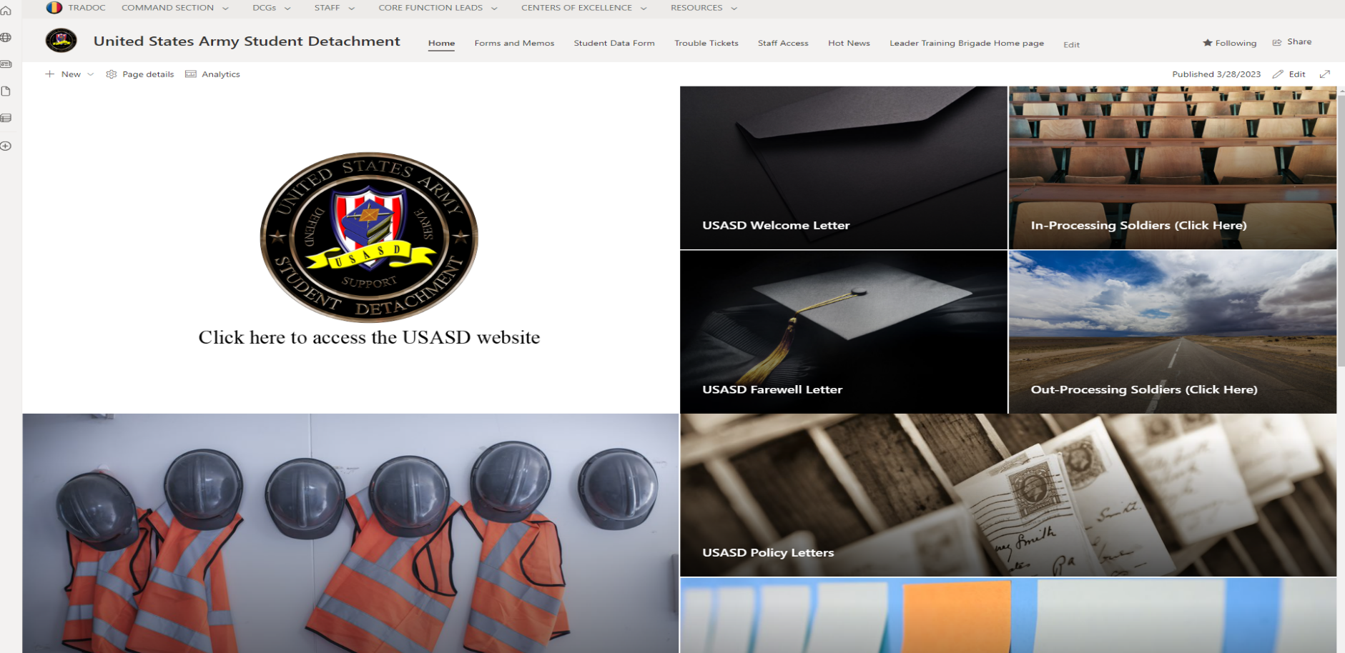
USASD In-Processing
All Students are required to use a CAC accessible computer with their Army 365 email authentication to gain access
Access SharePoint at United States Army Student Detachment - Home (sharepoint-mil.us) and communicate through Army 365 email
DO NOT in-process/create a file no earlier than 10 days before your report date
usarmy.jackson.CAC.mbx.usasd-in-processing@army.mil

Slide 9
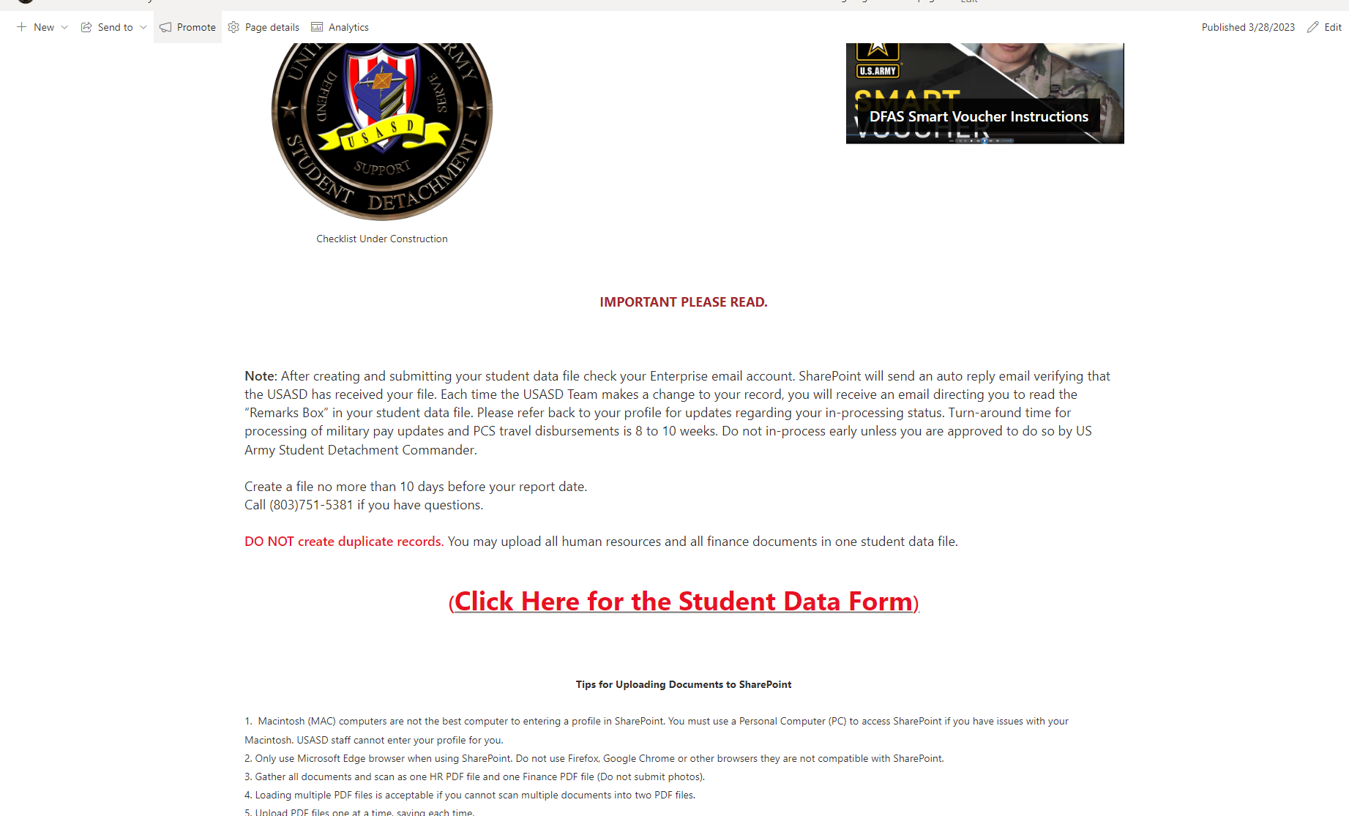
USASD In-Processing
On the Home Page "click" the In-Processing tile and scroll down until you find the Student Data Form.

Slide 10
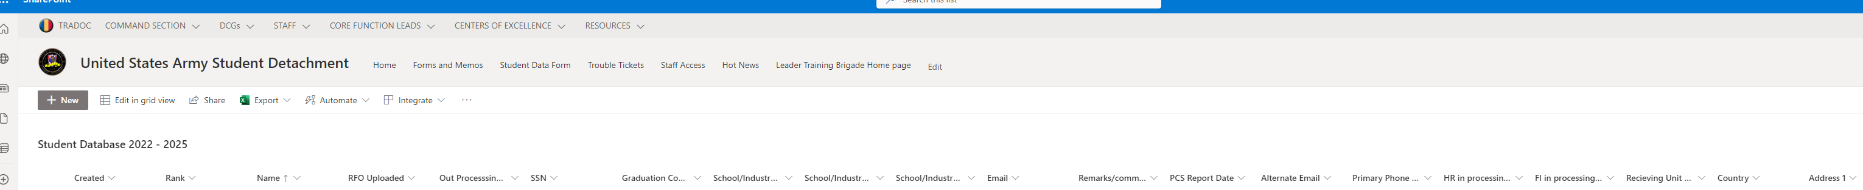
USASD In-Processing
On the Student Data Form, "click" on NEW and fill in all information and upload your documents.

Slide 11
USASD In-Processing
Soldiers will report by submitting their complete HR and finance documents via SharePoint. Scan your HR and finance documents into PDFs BEFORE logging into SharePoint. Ensure your absence request is submitted in IPPS-A according to the instructions provided in this document. If your In-Processing packet is not received, a notice will be sent to you by Army 365 email concerning your Failure to Report and risk of pay suspension
Do not submit photographs of your documents. Submit documents in PDF format to prevent delays in receiving your entitlements

Slide 12
USASD In-Processing
Student Data Form (SharePoint)
Required Documents
PCS Orders (To include amendments)
Absence Request (IPPS-A) send all i.e., PTDY, PCS
DA Form 5960 (form dated Jan 2022)
DD Form 93
Service Members' Group Life Insurance Certificate
DA Form 7415
ADPAAS “Print Screen"
Cyber Awareness Training Certificate
DD Form 1351-2 Travel Voucher (completed and signed)
GTCC Program and Statement of Understanding
GTCC Training Certificate
United States Army Student Detachment Policies Memorandum of Understanding (signed and dated)
* Ensure to submit all documents
8/23/2024

Slide 13
AMERICA’S ARMY:
Globally Responsive, Regionally Engaged
UNCLASS/FOUO
United States Army Student Detachment
ABSENCES

Slide 14
AMERICA’S ARMY:
Globally Responsive, Regionally Engaged
UNCLASS/FOUO
ABESENCE REQUEST
Servicing Human Resources Assistant Representative:
Additional information (Absence request) SharePoint Link:
https://armyeitaas.sharepoint-mil.us/sites/TR-CIMT-LTB-USASD
Email boxes for Team Able (P-Z) usarmy.jackson.tradoc.mbx.ltb-usasd-team-able@army.mil Email boxes for Team Brave (H-O) usarmy.jackson.tradoc.mbx.ltb-usasd-team-brave@army.mil Email boxes for Team Chosen (A-G) usarmy.jackson.tradoc.mbx.ltb-usasd-team-chosen@army.mil
For questions, duty hours: 1300hrs – 1600hrs (Monday-Fridays)
8/23/2024

Slide 15
Absence Request
AMERICA’S ARMY:
Globally Responsive, Regionally Engaged
UNCLASS/FOUO
Absence Request – IPPS-A
ALL Absence request MUST be submitted and processed through the Integrated Personnel And Pay Systems-Army.
List Mrs. Bost, Lori as the Supervisor- Employee ID- 0002800852.20 (For letter group P-Z).
List Mrs. Morris, Gayle as the Supervisor-Employee ID- 0003852688.20 (For letter group H-O).
List SSG Goldsmith, Drakkar as the Supervisor-Employee ID- 0003461428.01 (For letter group A-G).
Admin absence/House hunting (PTDY) is a separate request from an absence request or PCS absence request
Combined absences must cover all days that you are not present for duty. You must be on an
approved absence to begin your travel. Service members are not authorized to travel while on PTDY status.
Absence date must end the day before your report date
  (Example) Report Date: 21 September; Absence request last date: 20 September
Parental Absence
OCONUS Absence
8/23/2024

Slide 16
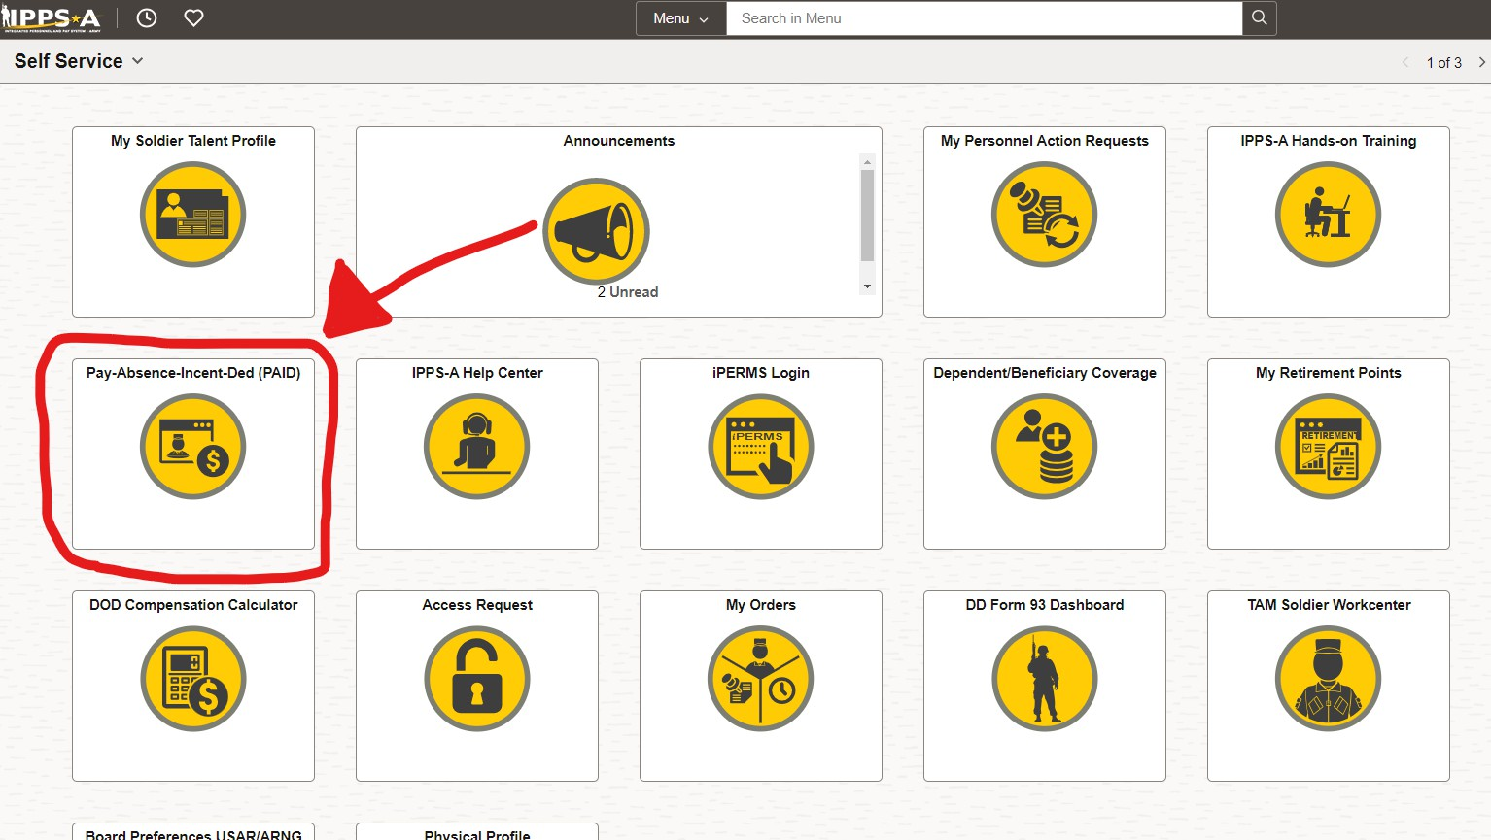
CLICK PAID (PAY-ABSENCE- INCENT-DED)
AMERICA’S ARMY:
Globally Responsive, Regionally Engaged
UNCLASS/FOUO

Slide 17
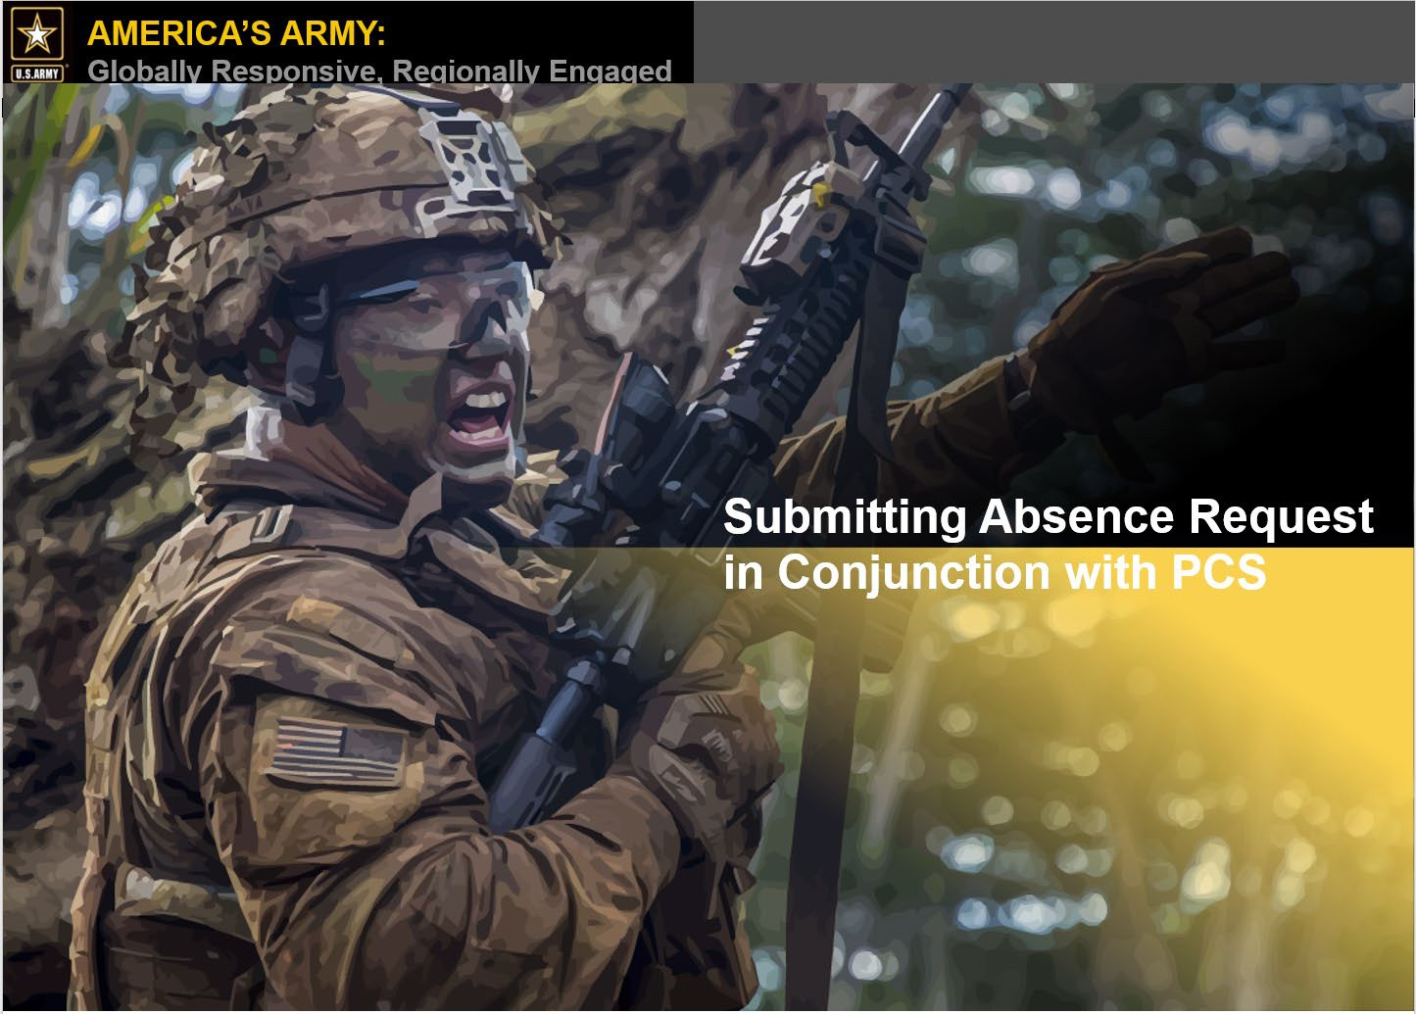
AMERICA’S ARMY:
Globally Responsive, Regionally Engaged
UNCLASS/FOUO
Absence Request
8/23/2024

Slide 18
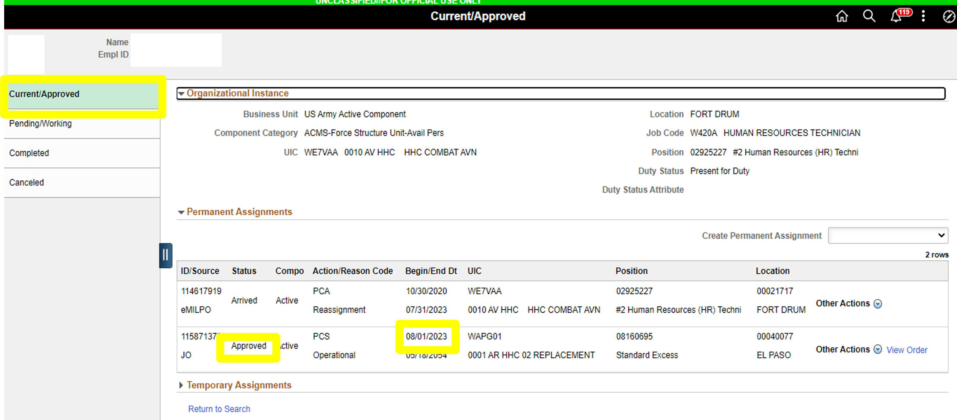


Absence Request
AMERICA’S ARMY:
Globally Responsive, Regionally Engaged
UNCLASS/FOUO
Service member has an approved assignment with a report date of 1 August 2023
View Orders
8/23/2024

Slide 19
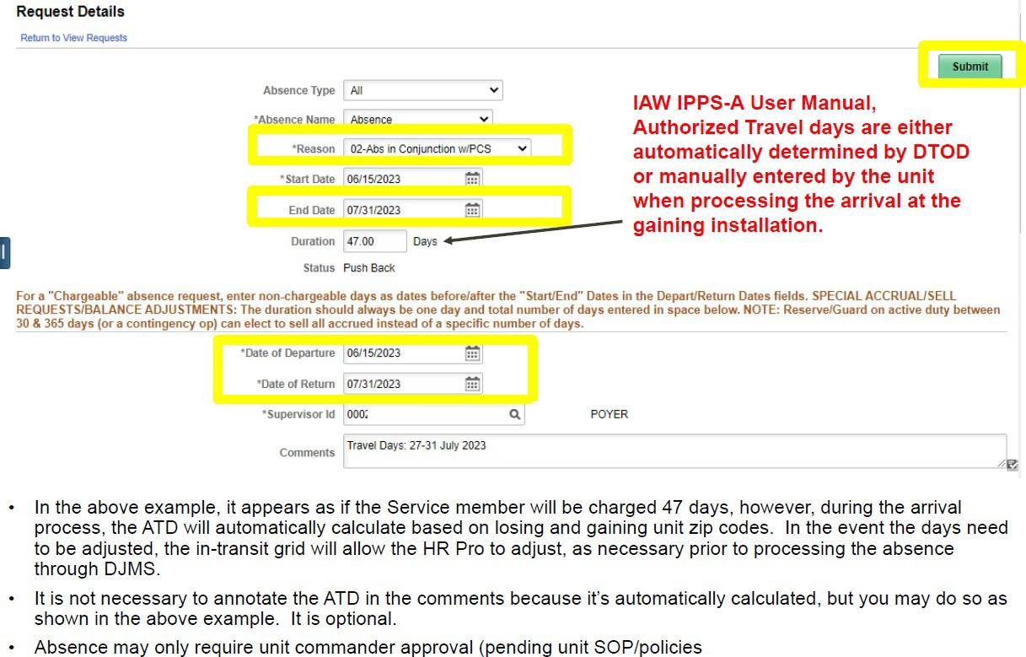
Absence Request (without House Hunting Absence)
AMERICA’S ARMY:
Globally Responsive, Regionally Engaged
UNCLASS/FOUO

Slide 20
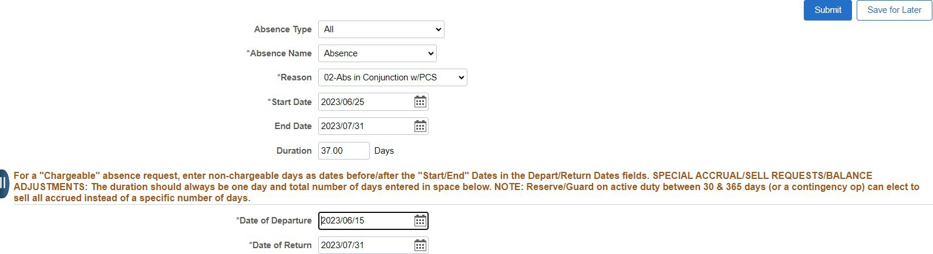
Absence Request (with House Hunting Absence)
AMERICA’S ARMY:
Globally Responsive, Regionally Engaged
UNCLASS/FOUO
Enter Chargeable days on top
Enter entire absence period
**Reminder**: Authorized Travel Days (ATD) will be automatically determined by Defense Table of Official Distance (DTOD) or manually entered by the unit when processing the arrival. The 37 chargeable days in the example above will adjust upon arrival to gaining unit
Absence may only require unit commander approval (pending unit SOP/policies)

Slide 21
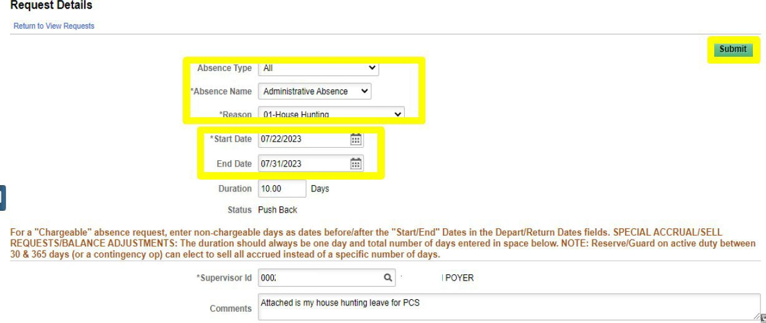
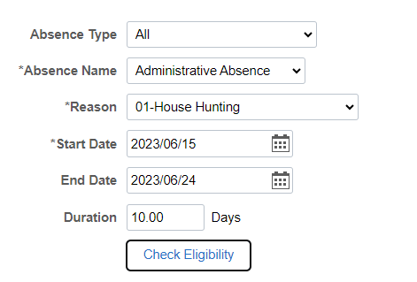
Absence Request (with House Hunting Absence)
AMERICA’S ARMY:
Globally Responsive, Regionally Engaged
UNCLASS/FOUO
Enter the House Hunting dates as shown above
House Hunting must be entered before the absence in conjunction with PCS period and must be included inside the entire absence period annotated as shown in the previous slide

Slide 22
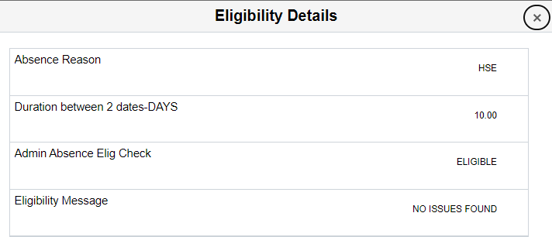

AMERICA’S ARMY:
Globally Responsive, Regionally Engaged
UNCLASS/FOUO
Absence Request Errors
Start and end date error means another absence is currently occupying the same dates. Fix the dates in the other absence before continuing with this one
Forecast error means you must click the “Check Eligibility” button. Then click the “View Eligibility Details” to see if there is an error
If you get no PCS assignment found, then you must put your PCS absence end date
to one (1) day prior to your PCS orders report date

Slide 23
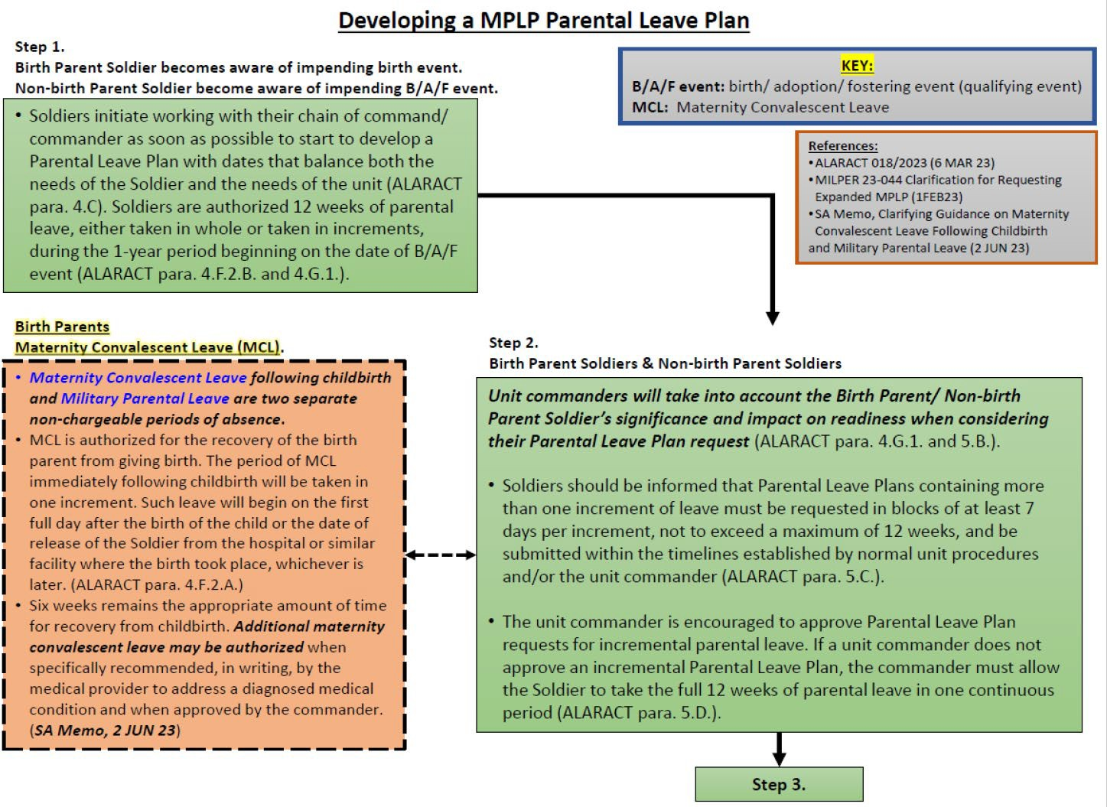
AMERICA’S ARMY:
Globally Responsive, Regionally Engaged
UNCLASS/FOUO
Parental Absence Request
8/23/2024

Slide 24
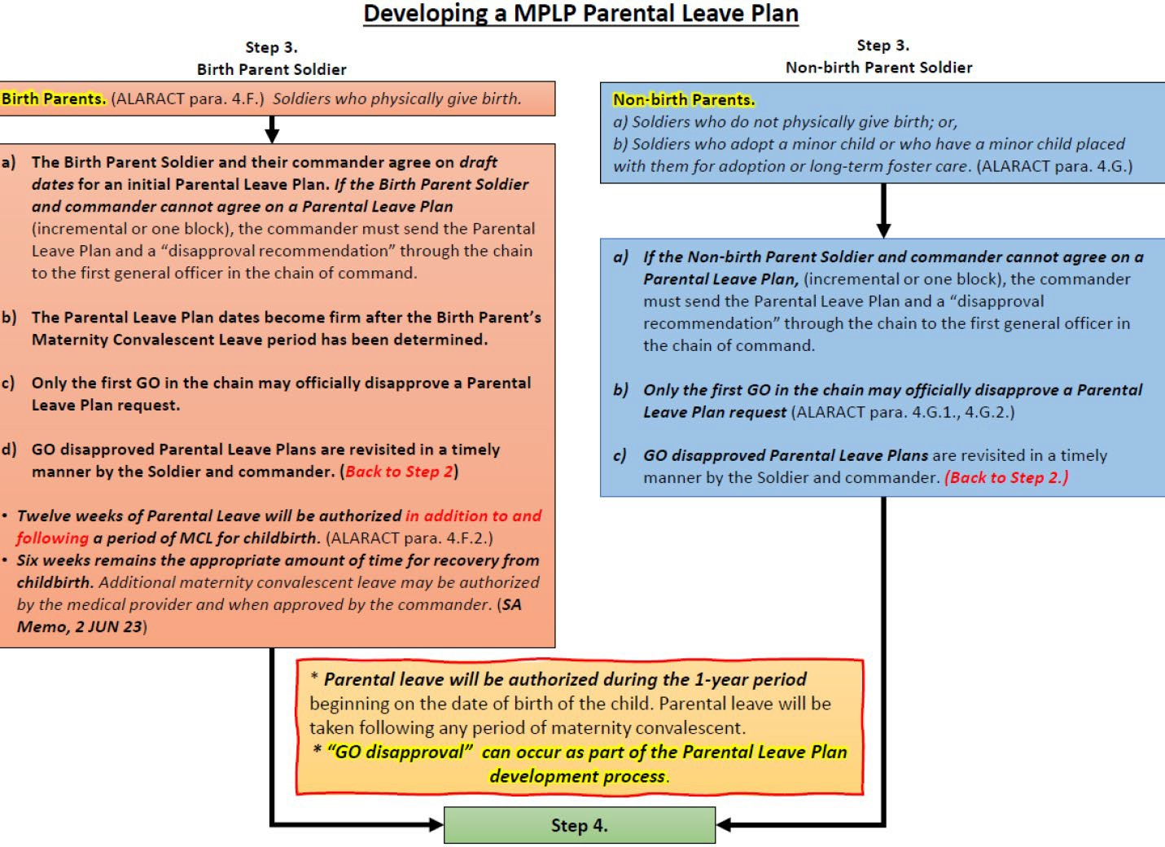
AMERICA’S ARMY:
Globally Responsive, Regionally Engaged
Parental Absence Request
UNCLASS/FOUO
8/23/2024

Slide 25
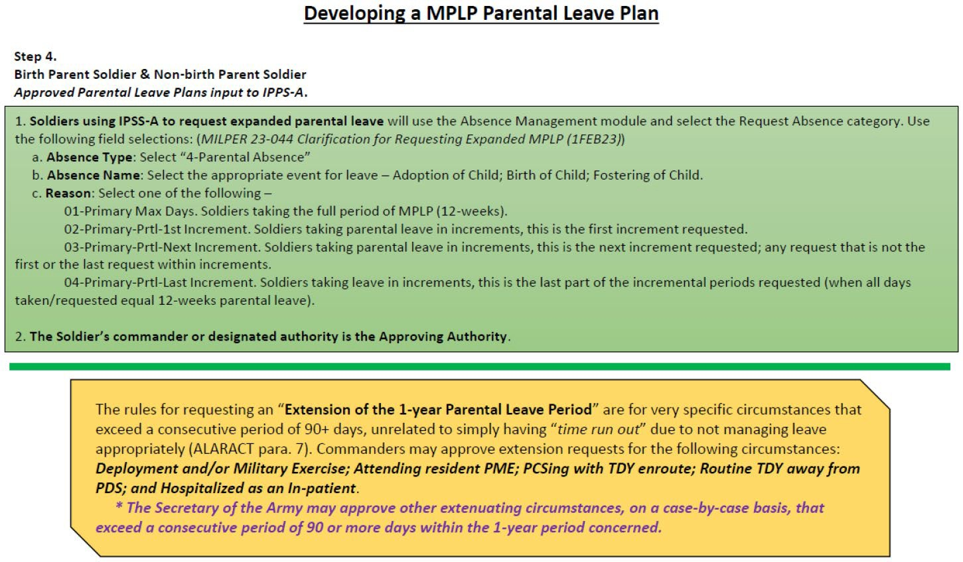
AMERICA’S ARMY:
Globally Responsive, Regionally Engaged
Parental Absence Request
UNCLASS/FOUO
8/23/2024

Slide 26
OCONUS Absence Request
AMERICA’S ARMY:
Globally Responsive, Regionally Engaged
UNCLASS/FOUO
OCONUS ABSENCE
OCONUS Absence request submitted through IPPS-A must include the following (NO EXCEPTIONS):
You must visit the Aircraft and Personnel Automated Clearance System, (APACS) at: https://apacs.milcloud.mil/apacs
Attach all documents required by the Foreign Clearance Guide
Refer to the Foreign Clearance Guide at: https://www.fcg.pentagon.mil/fcg.cfm
You will be able to view the country you will be traveling to. Read carefully to ensure all requirements for that country are met
8/23/2024

Slide 27
AMERICA’S ARMY:
Globally Responsive, Regionally Engaged
UNCLASS/FOUO
United States Army Student Detachment
FINANCE
SSG Negron Casiano

Slide 28
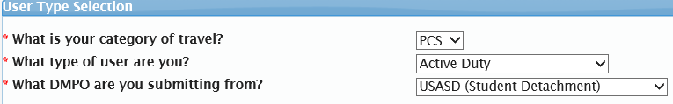
Smart Voucher
Special Instructions
Attach ALL documents to smart voucher:
  ORDERS
  Absence request
  RECIEPTS
Under location of TLE tab if the question below is not a yes, you will not receive TLE.
Questions on what is reimbursable?
- Refer to the Joint Travel Regulation (Chapter 1 - 6 )
DA 31 must be SIGNED in
USASD needs to be selected. If not, it will not come to us.

Slide 29
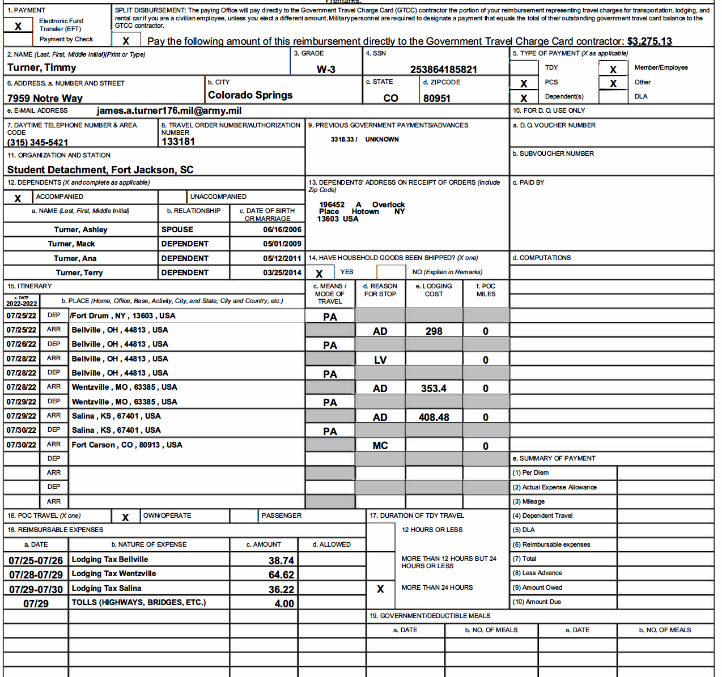

DD 1351-2 MAY 2011

Slide 30
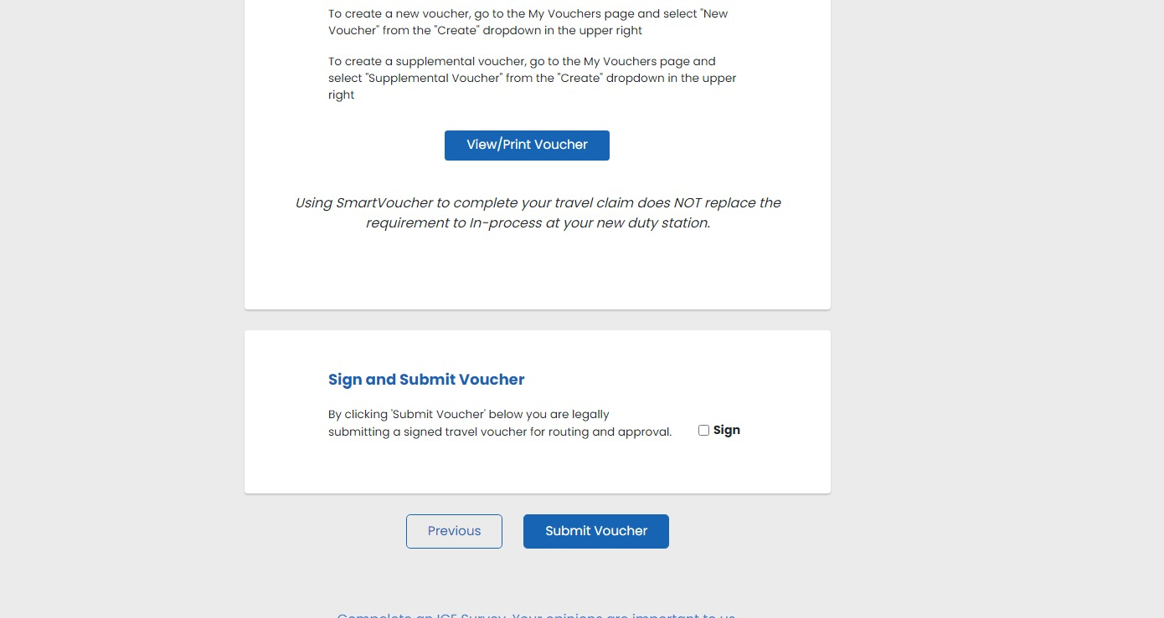
DD 1351-2 MAY 2011
Your SmartVoucher is not complete until you select the “sign box” and click “submit voucher”. Do not view/print voucher until after you complete those two steps!!

Slide 31
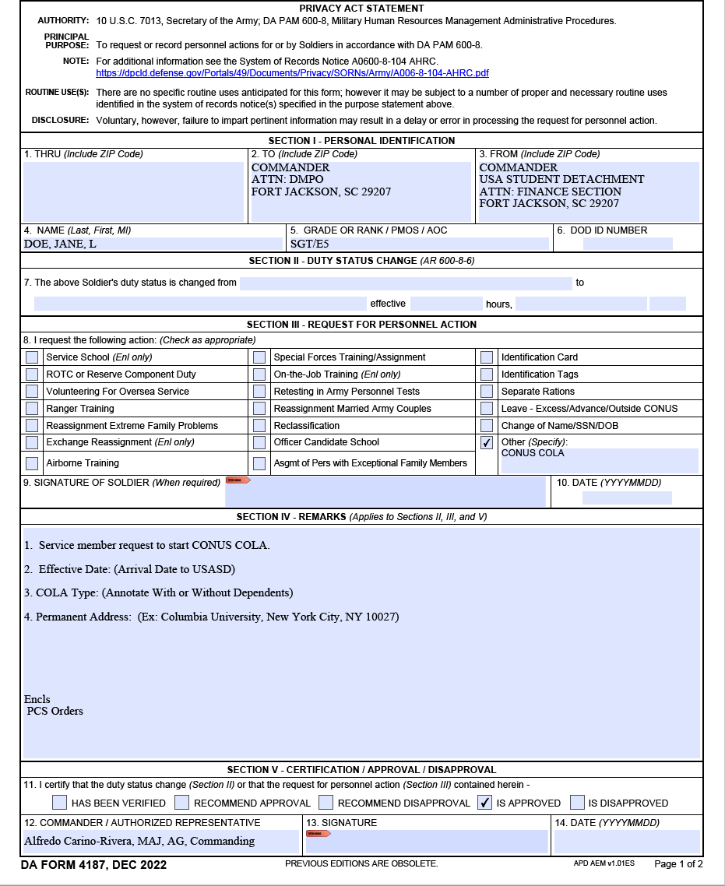
COLA DA 4187
# of Dependents. Do Not include yourself.

Slide 32
Questions
8/23/2024
49

